Slide 1
CSM 297
Database Concepts and Technologies I
Michael Franklin Bosu

Slide 2
Course Administration
Lectures (Wednesdays – 8-10am)
Labs
3 Assignments
Unannounced short examinations
Mid Semester Examination
Text Book:1. Fundamentals of Database Systems: 5th Edition by Elmasri/Navathe
2. Database Systems: 4th Edition by Connolly/Begg

Slide 3
Course Outline
Database Terminologies and Definitions
Database System Concepts and Architecture
Data Modelling Using the Entity-Relationship (ER) Model Mid Semester Examination
Relational Model: Concepts
The Relational Algebra and Relational Calculus
SQL-99: Schema Definition, Constraints, Queries,
and Views
Functional Dependencies and Normalisation for Relational Databases

Slide 4
Lecture 1
Introduction To Databases

Slide 5
Outline
Types of Databases and Database Applications
Characteristics of file-based systems.
Problems with file-based approach.
Basic Definitions
Typical DBMS Functionality
Example of a Database (UNIVERSITY)
Main Characteristics of the Database Approach
Advantages of Using the Database Approach
History of Databases

Slide 6
Types of Databases and Database Applications
Traditional Applications:
  Numeric and Textual Databases
More Recent Applications:
  Multimedia Databases
  Geographic Information Systems (GIS)
  Data Warehouses
  Real-time and Active Databases
  Many other applications

Slide 7
File-Based Systems
Collection of application programs that perform services for the end users (e.g. reports).
Each program defines and manages its own data.

Slide 8
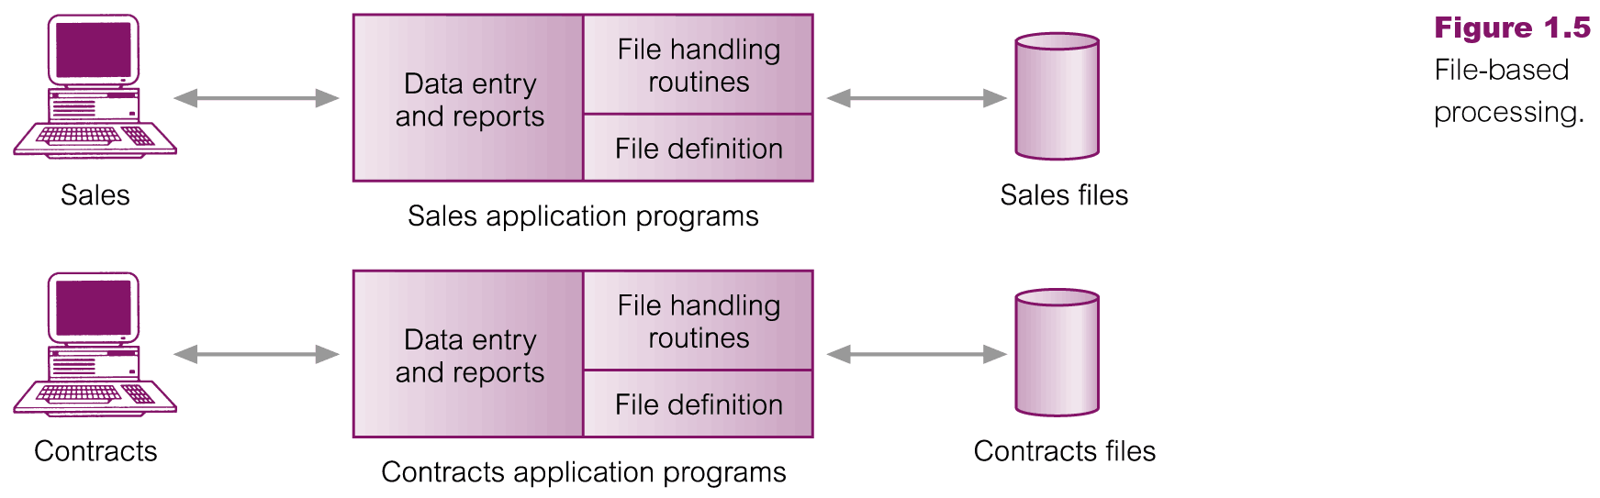
File-Based Processing

Slide 9
Limitations of File-Based Approach
Separation and isolation of data
  Each program maintains its own set of data.
  Users of one program may be unaware of potentially useful data held by other programs.
Duplication of data
  Same data is held by different programs.
  Wasted space and potentially different values and/or different formats for the same item.

Slide 10
Limitations of File-Based Approach
Data dependence
  File structure is defined in the program code.
Incompatible file formats
  Programs are written in different languages, and so cannot easily access each other’s files.
Fixed Queries/Proliferation of application programs
  Programs are written to satisfy particular functions.
  Any new requirement needs a new program.

Slide 11
Database Approach
Arose because:
  Definition of data was embedded in application programs, rather than being stored separately and independently.
  No control over access and manipulation of data beyond that imposed by application programs.
Result:
  the database and Database Management System (DBMS).

Slide 12
Basic Definitions
Database:
  A collection of related data.
Data:
  Known facts that can be recorded and have an implicit meaning.
Mini-world:
  Some part of the real world about which data is stored in a database. For example, student grades and transcripts at a university.
Database Management System (DBMS):
  A software package/ system to facilitate the creation and maintenance of a computerized database.
Database System:
  The DBMS software together with the data itself. Sometimes, the applications are also included.

Slide 13

Simplified database system environment

Slide 14
Typical DBMS Functionality
Define a particular database in terms of its data types, structures, and constraints
Construct or Load the initial database contents on a secondary storage medium
Manipulating the database:
  Retrieval: Querying, generating reports
  Modification: Insertions, deletions and updates to its content
  Accessing the database through Web applications
Processing and Sharing by a set of concurrent users and application programs – yet, keeping all data valid and consistent

Slide 15
Typical DBMS Functionality
Other features:
  Protection or Security measures to prevent unauthorized access
  “Active” processing to take internal actions on data
  Presentation and Visualization of data
  Maintaining the database and associated programs over the lifetime of the database application
    Called database, software, and system maintenance

Slide 16
Example of a Database
(with a Conceptual Data Model)
Mini-world for the example:
  Part of a UNIVERSITY environment.
Some mini-world entities:
  STUDENTs
  COURSEs
  SECTIONs (of COURSEs)
  (academic) DEPARTMENTs
  INSTRUCTORs

Slide 17
Example of a Database
(with a Conceptual Data Model)
Some mini-world relationships:
  SECTIONs are of specific COURSEs
  STUDENTs take SECTIONs
  COURSEs have prerequisite COURSEs
  INSTRUCTORs teach SECTIONs
  COURSEs are offered by DEPARTMENTs
  STUDENTs major in DEPARTMENTs

Slide 18

Example of a simple database

Slide 19
Main Characteristics of the Database Approach
Self-describing nature of a database system:
  A DBMS catalog stores the description of a particular database (e.g. data structures, types, and constraints)
  The description is called meta-data.
  This allows the DBMS software to work with different database applications.
Insulation between programs and data:
  Called program-data independence.
  Allows changing data structures and storage organization without having to change the DBMS access programs.

Slide 20

Example of a simplified database catalog

Slide 21
Main Characteristics of the Database Approach (continued)
Data Abstraction:
  A data model is used to hide storage details and present the users with a conceptual view of the database.
  Programs refer to the data model constructs rather than data storage details
Support of multiple views of the data:
  Each user may see a different view of the database, which describes only the data of interest to that user.

Slide 22
Main Characteristics of the Database Approach (continued)
Sharing of data and multi-user transaction processing:
  Allowing a set of concurrent users to retrieve from and to update the database.
  Concurrency control within the DBMS guarantees that each transaction is correctly executed or aborted
  Recovery subsystem ensures each completed transaction has its effect permanently recorded in the database
  OLTP (Online Transaction Processing) is a major part of database applications. This allows hundreds of concurrent transactions to execute per second.

Slide 23
Historical Development of Database Technology
Early Database Applications:
  The Hierarchical and Network Models were introduced in mid 1960s and dominated during the seventies.
  A bulk of the worldwide database processing still occurs using these models, particularly, the hierarchical model.
Relational Model based Systems:
  Relational model was originally introduced in 1970, was heavily researched and experimented within IBM Research and several universities.
  Relational DBMS Products emerged in the early 1980s.

Slide 24
End

